Slide 1

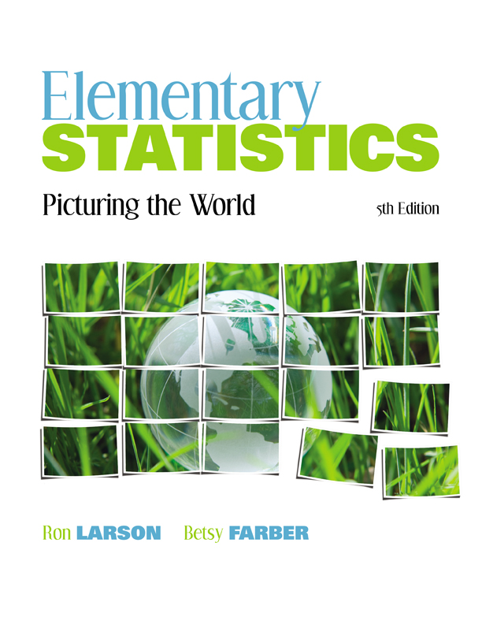

Chapter
2
Descriptive Statistics
© 2012 Pearson Education, Inc.
All rights reserved.
<number> of 149

Slide 2
Chapter Outline
2.5 Measures of Position
© 2012 Pearson Education, Inc. All rights reserved.
<number> of 149

Slide 3
Section 2.5
Measures of Position
© 2012 Pearson Education, Inc. All rights reserved.
<number> of 149

Slide 4
Section 2.5 Objectives
Determine the quartiles of a data set
Determine the interquartile range of a data set
Create a box-and-whisker plot
Interpret other fractiles such as percentiles
Determine and interpret the standard score (z-score)
© 2012 Pearson Education, Inc. All rights reserved.
<number> of 149

Slide 5
Quartiles
Fractiles are numbers that partition (divide) an ordered data set into equal parts.
Quartiles approximately divide an ordered data set into four equal parts.
  First quartile, Q₁: About one quarter of the data fall on or below Q₁.
  Second quartile, Q₂: About one half of the data fall on or below Q₂ (median).
  Third quartile, Q₃: About three quarters of the data fall on or below Q₃.
© 2012 Pearson Education, Inc. All rights reserved.
<number> of 149

Slide 6
Example: Finding Quartiles
The number of nuclear power plants in the top 15 nuclear power-producing countries in the world are listed. Find the first, second, and third quartiles of the data set.
7 18 11 6 59 17 18 54 104 20 31 8 10 15 19
Solution:
Q₂ divides the data set into two halves.
6 7 8 10 11 15 17 18 18 19 20 31 54 59 104
Lower half
Upper half
Q₂
© 2012 Pearson Education, Inc. All rights reserved.
<number> of 149

Slide 7
Solution: Finding Quartiles
The first and third quartiles are the medians of the lower and upper halves of the data set.
6 7 8 10 11 15 17 18 18 19 20 31 54 59 104
Lower half
Upper half
Q₁
Q₂
Q₃
About one fourth of the countries have 10 or fewer nuclear power plants; about one half have 18 or fewer; and about three fourths have 31 or fewer.
© 2012 Pearson Education, Inc. All rights reserved.
<number> of 149

Slide 8
Interquartile Range
Interquartile Range (IQR)
The difference between the third and first quartiles.
IQR = Q₃ – Q₁
© 2012 Pearson Education, Inc. All rights reserved.
<number> of 149

Slide 9
Example: Finding the Interquartile Range
Find the interquartile range of the data set.
7 18 11 6 59 17 18 54 104 20 31 8 10 15 19
Recall Q₁ = 10, Q₂ = 18, and Q₃ = 31
Solution:
IQR = Q₃ – Q₁ = 31 – 10 = 21
The number of power plants in the middle portion of the data set vary by at most 21.
© 2012 Pearson Education, Inc. All rights reserved.
<number> of 149

Slide 10
Box-and-Whisker Plot
Box-and-whisker plot
Exploratory data analysis tool.
Highlights important features of a data set.
Requires (five-number summary):
  Minimum entry
  First quartile Q₁
  Median Q₂
  Third quartile Q₃
  Maximum entry
© 2012 Pearson Education, Inc. All rights reserved.
<number> of 149

Slide 11
Drawing a Box-and-Whisker Plot
Find the five-number summary of the data set.
Construct a horizontal scale that spans the range of the data.
Plot the five numbers above the horizontal scale.
Draw a box above the horizontal scale from Q₁ to Q₃ and draw a vertical line in the box at Q₂.
Draw whiskers from the box to the minimum and maximum entries.
Box
Whisker
Whisker
Minimum entry
Maximum entry
Q₁
Median, Q₂
Q₃
© 2012 Pearson Education, Inc. All rights reserved.
<number> of 149

Slide 12
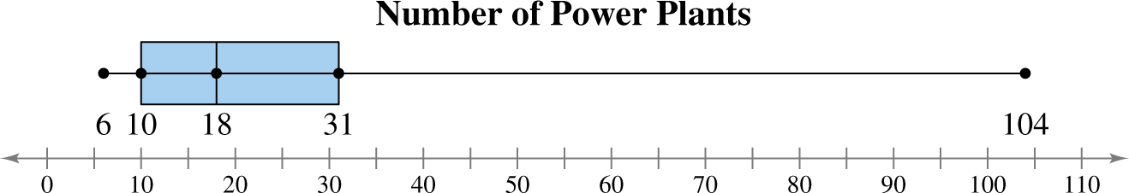
Example: Drawing a Box-and-Whisker Plot
Draw a box-and-whisker plot that represents the data set.
7 18 11 6 59 17 18 54 104 20 31 8 10 15 19
Min = 6, Q₁ = 10, Q₂ = 18, Q₃ = 31, Max = 104,
Solution:
About half the data values are between 10 and 31. By looking at the length of the right whisker, you can conclude 104 is a possible outlier.
© 2012 Pearson Education, Inc. All rights reserved.
<number> of 149

Slide 13
Percentiles and Other Fractiles
Fractiles | Summary | Symbols
Quartiles | Divide a data set into 4 equal parts | Q₁, Q₂, Q₃
Deciles | Divide a data set into 10 equal parts | D₁, D₂, D₃,…, D₉
Percentiles | Divide a data set into 100 equal parts | P₁, P₂, P₃,…, P₉₉
© 2012 Pearson Education, Inc. All rights reserved.
<number> of 149

Slide 14
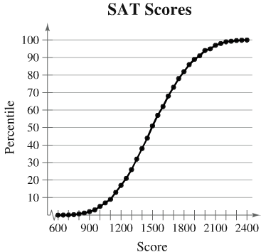
Example: Interpreting Percentiles
The ogive represents the cumulative frequency distribution for SAT test scores of college-bound students in a recent year. What test score represents the 62nd percentile? How should you interpret this? (Source: College Board)
© 2012 Pearson Education, Inc. All rights reserved.
<number> of 149

Slide 15
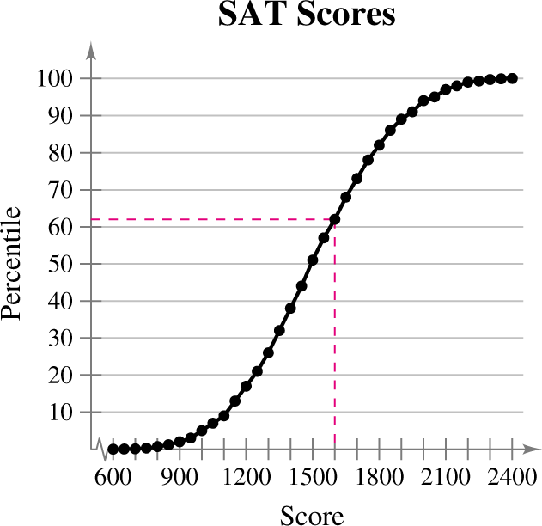
Solution: Interpreting Percentiles
The 62nd percentile corresponds to a test score of 1600.
This means that 62% of the students had an SAT score of 1600 or less.
© 2012 Pearson Education, Inc. All rights reserved.
<number> of 149

Slide 16
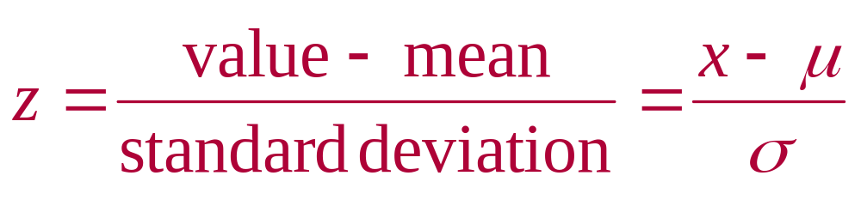
The Standard Score
Standard Score (z-score)
Represents the number of standard deviations a given value x falls from the mean μ.
© 2012 Pearson Education, Inc. All rights reserved.
<number> of 149

Slide 17

Example: Comparing z-Scores from Different Data Sets
In 2009, Heath Ledger won the Oscar for Best Supporting Actor at age 29 for his role in the movie The Dark Knight. Penelope Cruz won the Oscar for Best Supporting Actress at age 34 for her role in Vicky Cristina Barcelona. The mean age of all Best Supporting Actor winners is 49.5, with a standard deviation of 13.8. The mean age of all Best Supporting Actress winners is 39.9, with a standard deviation of 14.0. Find the z-scores that correspond to the ages of Ledger and Cruz. Then compare your results.
© 2012 Pearson Education, Inc. All rights reserved.
<number> of 149

Slide 18
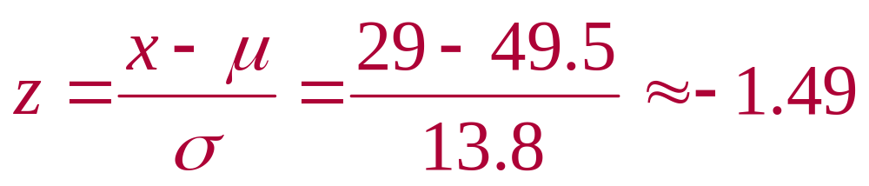
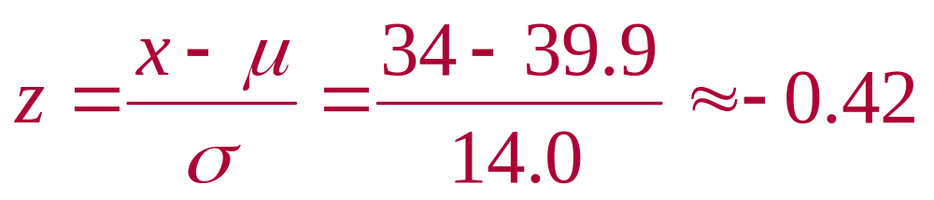
Solution: Comparing z-Scores from Different Data Sets
Heath Ledger
1.49 standard deviations below the mean
Penelope Cruz
0.42 standard deviations below the mean
© 2012 Pearson Education, Inc. All rights reserved.
<number> of 149

Slide 19
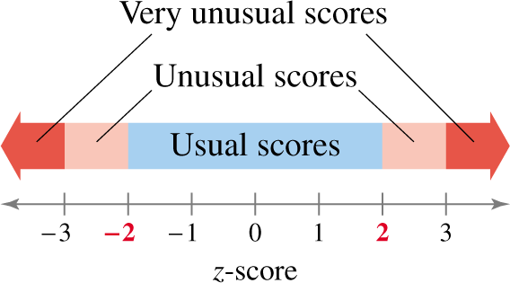
Solution: Comparing z-Scores from Different Data Sets
Both z-scores fall between –2 and 2, so neither score would be considered unusual. Compared with other Best Supporting Actor winners, Heath Ledger was relatively younger, whereas the age of Penelope Cruz was only slightly lower than the average age of other Best Supporting Actress winners.
© 2012 Pearson Education, Inc. All rights reserved.
<number> of 149

Slide 20
Section 2.5 Summary
Determined the quartiles of a data set
Determined the interquartile range of a data set
Created a box-and-whisker plot
Interpreted other fractiles such as percentiles
Determined and interpreted the standard score
(z-score)
© 2012 Pearson Education, Inc. All rights reserved.
<number> of 149

